Slide 1
UNIT II

Slide 2
Searching
Searching operation is to find an element in an array. The searching operations is performed in two ways.
1.Linear search (Sequential search)
2.Binary search
Linear search
* Linear search is the simplest search algorithm.
*In this type of search, a sequential search is made over all items one by one.
*Every item is checked and if a match is found then that particular item is returned, otherwise the search continues till the end of the data collection.

Slide 3
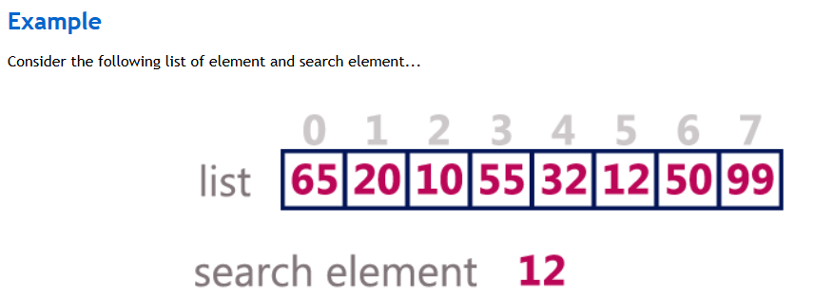
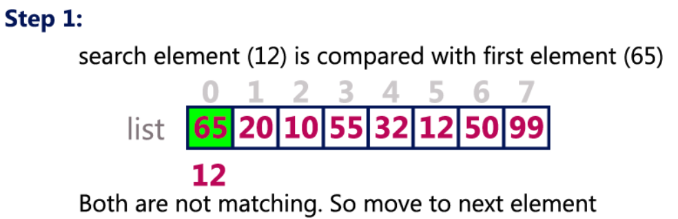

Slide 4
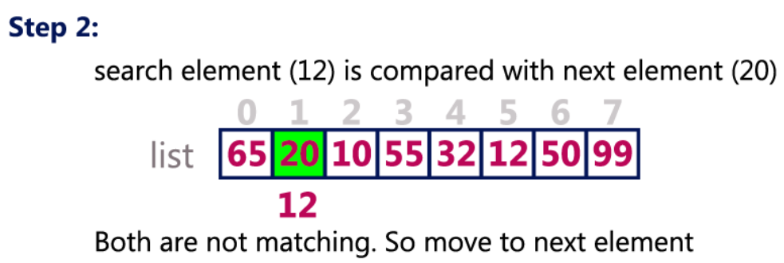
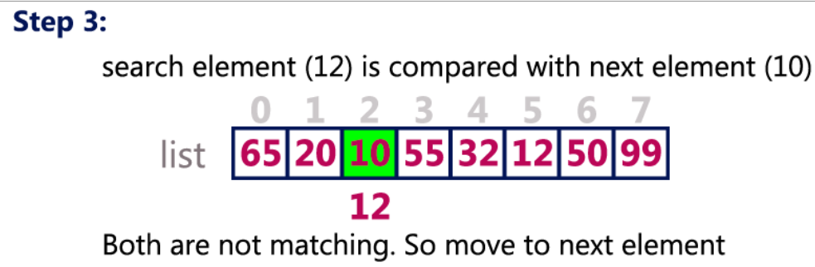

Slide 5
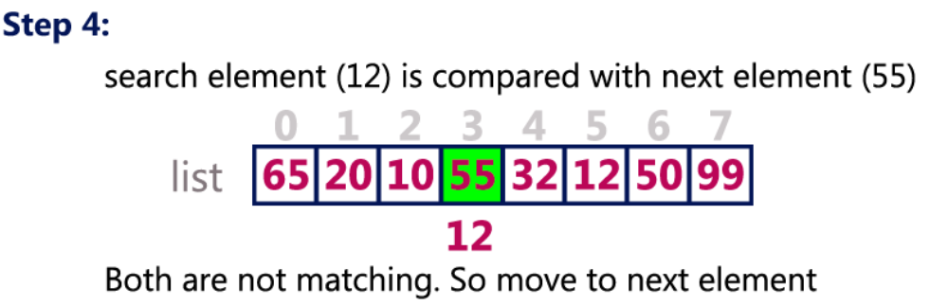
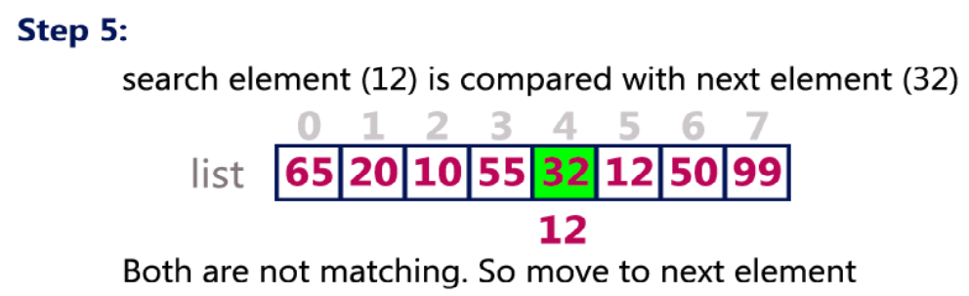

Slide 6
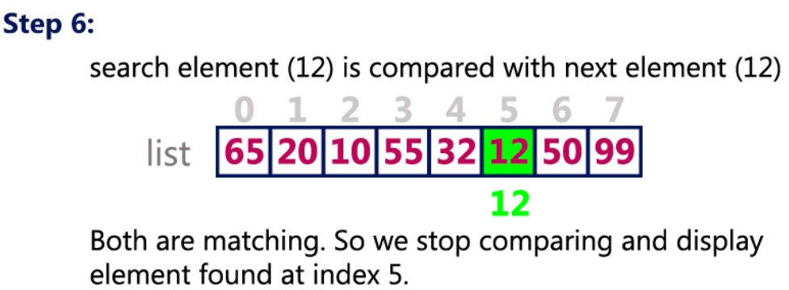

Slide 7
Algorithm
A is an array of N elements
ITEM is element to be searchd
i is the counter
Step1: set i=0; flag=1;
Step2: repeat step3 and step 4 while(i<N)
Step3: if a[i]==item
flag=0;
Output search successful and element found at i+1 position
go to step6
Step 4: set i=i+1
Step 5: if (flag ==1)
Output search successful
Step6: Exit

Slide 8
Tracing
Let a[5] = {10,20,30,40,50} N=5, Item =30
Step1: set i=0; flag=1;
Step2: repeat step3 and step 4 while(0<5)
Step3: if a[0]==30 10==30 //false
Step 4: set i=i+1 i=0+1=1
Step2: repeat step3 and step 4 while(1<5)
Step3: if a[1]==30 20==30 //false
Step 4: set i=i+1 i=1+1=2
Step2: repeat step3 and step 4 while(2<5)
Step3: if a[2]==30 30==30 //true
flag=0;
Output search successful and element found at i+1 position
go to step6
Step6: Exit

Slide 9
search for the largest and smallest element in an array of integers using sequential search
Algorithm
Step1: Start
Step2: Read the size of the array
Step3: Read the array elements
Step4: Initialize large=a[0],small=a[0]
Step 5: Repeat the following steps 6 and 7 for i=1 to n
Step6:If a[i]>large
large=a[i]
End if
Step 7: If a[i]<small
small=a[i]
End if [end for]
Step 8:Print large and small
Step 9: Stop

Slide 10
Program to search for the largest and smallest element in an array of integers using sequential search*/
#include<stdio.h>
void main()
{
int n,i,item,a[10],large,small;
clrscr();
printf("\nEnter the number of elements :");
scanf("%d",&n);
printf("\n Enter the elements \n",n);
for(i=0;i<n;i++)
{
scanf("%d",&a[i]);
}
printf("\nThe entered list is \n");
for(i=0;i<n;i++)
{
printf("%d\t",a[i]);
}
large=a[0];
small=a[0];
for(i=0;i<n;i++)
{
if(a[i]>large)
large=a[i];
if(a[i]<small)
small=a[i];
}
printf("\n The larget element = %d and smallest element=%d\n",large,small);
getch();
}

Slide 11
Bubble sort
Bubble Sort is an algorithm which is used to sort N elements that are given in a memory .
For eg: an Array with N number of elements. Bubble Sort compares all the element one by one and sort them based on their values.
Sorting takes place by stepping through all the data items one-by-one in pairs and comparing adjacent data items and swapping each pair that is out of order.
Example
We take an unsorted array

Slide 12
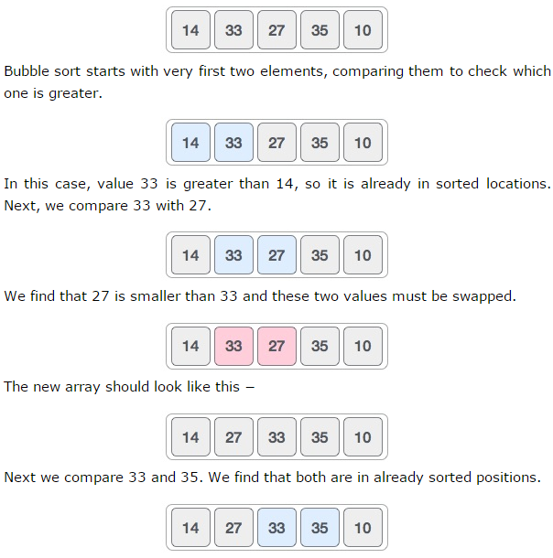

Slide 13
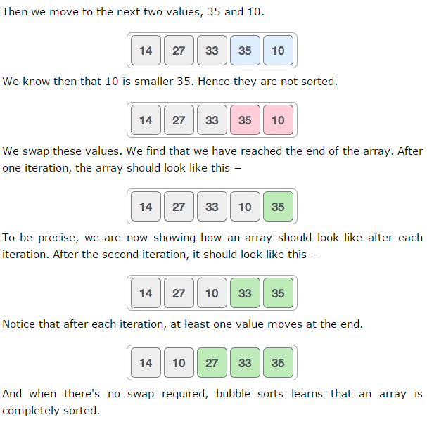

Slide 14
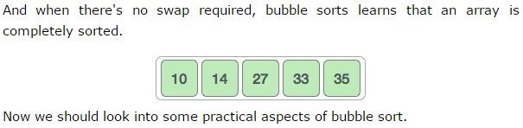

Slide 15
Algorithm
A is an array of n elements. The variable i and j are used to index the array elements.
Step1: Start
Step2: Read the size of the array in to variable n
Step3: Read the array elements
Step4: Repeat the following steps 5 and 6 for i=0 to n-1
Step 5: Repeat step 6 for j=0 to n-i-1
Step 6: If (a[j]>=a [j+1])
Swap a[j] with a[j+1]
[End if]
[end of step 4 for loop]
[end of step 5 for loop]
Step 7: print the sorted list
Step 8: Stop

Slide 16
Program
int a[6] = {5, 1, 6, 2, 4, 3};
int i, j, temp;
for(i=0; i<6; i++)
{
for(j=0; j<6-i-1; j++)
{
if( a[j] > a[j+1])
{
temp = a[j];
a[j] = a[j+1];
a[j+1] = temp;
} } }

Slide 17
Example:
Let us take the array of numbers 5 1 4 2 8 and sort the array in ascending order using bubble sort algorithm. In each step, elements written in bold are being compared.
Pass 1: ( 5 1 4 2 8 ) ( 1 5 4 2 8 ), Here, algorithm compares the first two elements, and
swaps them , since 5>1. ( 1 5 4 2 8 ) ( 1 4 5 2 8 ), Swap since 5 > 4 ( 1 4 5 2 8 ) ( 1 4 2 5 8 ), Swap since 5 > 2 ( 1 4 2 5 8 ) ( 1 4 2 5 8 ), Now, since these elements are already in order (5<8),
algorithm does not swap them. After pass 1 , 8 has come to its position Pass 2:
( 1 4 2 5 8 ) ( 1 4 2 5 8 ) No Swap since1<4 ( 1 4 2 5 8 ) ( 1 2 4 5 8 ), Swap since 4 > 2 ( 1 2 4 5 8 ) ( 1 2 4 5 8 ) , No Swap since4<5 ( 1 2 4 5 8 ) ( 1 2 4 5 8 ) Now, the array is already sorted, but our algorithm does not know if it is completed. The algorithm needs one whole pass without any swap to know it is sorted. After pass 2 , 5 has come to its position and 2 elements are arranged. Pass 3:
( 1 2 4 5 8 ) ( 1 2 4 5 8 ) No Swap since1<2 ( 1 2 4 5 8 ) ( 1 2 4 5 8 ) No Swap since2<4
After pass 3, 4 has come to its position and 3 elements are sorted.
Pass 4:
( 1 2 4 5 8 ) ( 1 2 4 5 8 ) No Swap since1<2 After pass 4, 2 has come to its position and 4 elements are sorted.
Finally, the array is sorted, and the algorithm can terminate.

Slide 18
//Program to sort a list of N elements using Bubble Sort
#include<stdio.h>
void main()
{
int n,i,j,temp,a[100];
clrscr();
printf("\nEnter the size of array :");
scanf("%d",&n);
printf("\n Enter the elements\n");
for(i=0;i<n;i++)
{
scanf("%d",&a[i]);
}
printf("Entered array is\n");

Slide 19
for(i=0;i<n;i++)
{
printf("%d\t",a[i]);
}
for(i=0;i<n-1;i++)
{
for(j=0;j<n-i-1;j++)
{
if(a[j]>=a[j+1])
{
temp=a[j];
a[j]=a[j+1];
a[j+1]=temp;
}
}
}

Slide 20
printf("\nThe sorted array\n");
for(i=0;i<n;i++)
{
printf("%d\t",a[i]);
}
getch();
}

Slide 21
Binary Search
An element can be found in an ordered list by using Binary search. In this the search element is compared with the middle element in the list. If the search element is lesser than the middle element the binary search is performed again only on the elements to the left of the middle element. If the search element is greater than the middle element then the search is made to the right of middle element. This process continues until the desired element is found or the search list becomes empty.

Slide 22
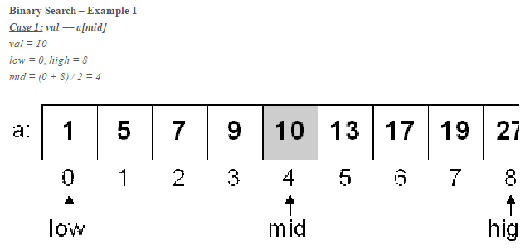
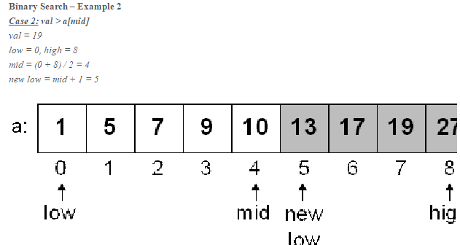

Slide 23
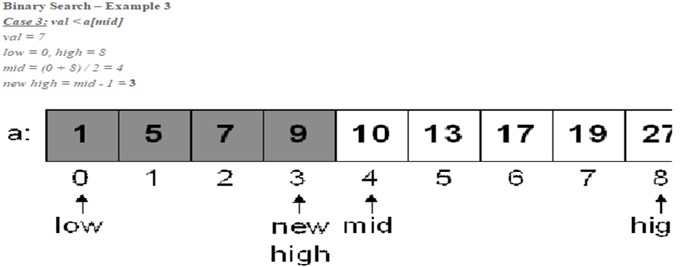

Slide 24
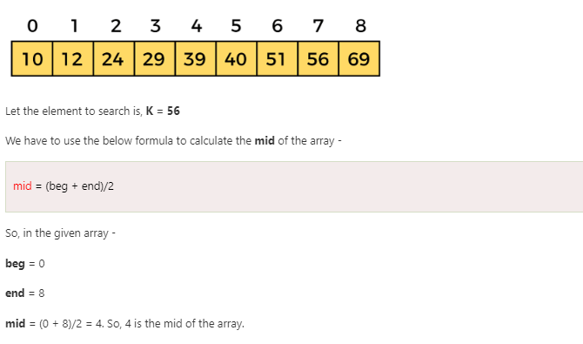

Slide 25
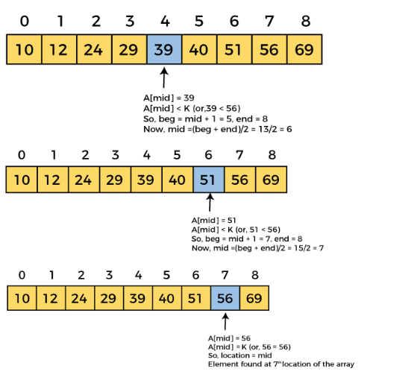

Slide 26
Example:
Consider the elements in array A
11 22 33 44 where n=4
and search element ITEM is 11
low = 0(lower bound)
high = 3(upper bound)
mid = (0+3)/2 =1
ITEM<A[mid] so go to the lower half segment.
Therefore reset the value of high to mid-1
low=0 high=0
mid=0
ITEM= =A[0] and search element 11 is found at position 1 (mid+1).

Slide 27
Consider the search element 77 in the above list 11 22 33 44
low = 0(lower bound)
high = 3(upper bound)
mid = (0+3)/2 =1
A[mid]=22
ITEM>A[mid] so go to the upper half segment.
Therefore reset the value of low to mid+1
low=2 high=3
mid=2
A[mid]=33
ITEM>A[mid] so go to the upper half segment.
Therefore reset the value of low to mid+1

Slide 28
low=3 high=3
mid=3
a[mid]=44
ITEM>A[mid] so go to the upper half segment.
Therefore reset the value of low to mid+1
low=4
Now low>high and therefore conclude that the element is not found in the list.

Slide 29
Algorithm
A is an array of n elements and item is the element to be searched in the array. The variables low and high identify the positions of the first and last elements in a range and mid identifies the position of the middle element.
Step1: Start
Step2: Read the size of the array
Step3: Read the array elements
Step4: Sort the array in ascending order
Step4: Read the search element to the variable item
Step5: while low<=high, do the following steps 6 to 8
Step6: Calculate mid=(low+high)/2
Step7: If(item=a[mid])

Slide 30
Step7: If(item=a[mid])
Print element found
Set flag=1
break
Else if(item>a[mid])
low=mid+1
Else (item<a[mid])
high=mid-1
End if
Step 8: Go to step1
Step 9 : if flag == 0
Print The item is not found.
Step 10: stop.

Slide 31
Step7: If(item=a[mid])
Print element found
Set flag=1
break
Else if(item>a[mid])
low=mid+1
Else (item<a[mid])
high=mid-1
End if
Step 8: Go to step1
Step 9 : if flag == 0
Print The item is not found.
Step 10: stop.

Slide 32
//Program to search for an element in an array using Binary search
#include<stdio.h>
void main()
{ int a[10],i,j,n,mid,temp,flag=0;
int low=0,high,item;
clrscr();
printf("\n Enter the number of elements: ");
scanf("%d",&n);
high=n-1;
printf("\n Enter the elements\n");
for(i=0;i<n;i++)
{
scanf("%d",&a[i]);
}

Slide 33
for(i=0;i<n-1;i++)
{
for(j=0;j<n-i-1;j++)
{
if(a[j]>a[j+1]) {
temp=a[j];
a[j]=a[j+1];
a[j+1]=temp;
}
}
}
printf("\nEnter the element to be searched :");
scanf("%d",&item);
while(low<=high)
{
mid=(low+high)/2;
if(a[mid]==item)
{
printf("\nElement %d is found in the list\n",item);
flag=1;
break;
}

Slide 34
else
{
if(item>a[mid])
{
low=mid+1;
}
else
{
high=mid-1;
}
}
}
if(flag==0)
{
printf("\n Item %d is not found",item);
}
getch();
}

Slide 35
Comparison of Linear search and Binary Search:
Linear Search | Binary Search
Number of comparisons made to search for an element is more. | Number of comparisons made to search for an element is less.
This method does not require list to be sorted. | This method can work only on sorted list.
This algorithm is slower. | This algorithm is fast.

Slide 36
Selection sort:
Selection sorting is conceptually the most simplest sorting algorithm. This algorithm first finds the smallest element in the array and exchanges it with the element in the first position, then find the second smallest element and exchange it with the element in the second position, and continues in this way until the entire array is sorted.

Slide 37
Consider the elements 63 75 90 12 27.
Pass 1 :
Find the smallest element in the list.12 is the smallest element. Exchange it with the element in the 1st position.12, 75, 90, 63, 27. 12 have come to its original position in the sorted list.
Pass 2:
Consider the remaining elements 75,90,63,27 and find the smallest among them.27 is the smallest element. Exchange it with the element at 2nd position.12, 27, 90, 63, 75.Now the 2 elements 12 and 27 are in their correct positions.
Pass 3:
Consider the remaining elements90, 63, 75 and find the smallest among them.63 is the smallest element. Exchange it with the element at 3rd position.12, 27, 63, 90, 75.

Slide 38
Pass 4:
Consider the remaining elements 90, 75. Find the smallest among them. Exchange 75 with the element in 4th position.12, 27, 63, 75, 90

Slide 39
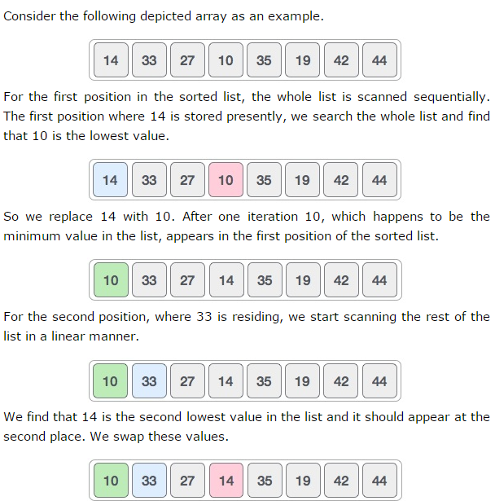

Slide 40
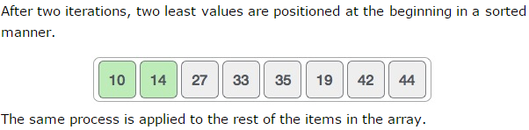
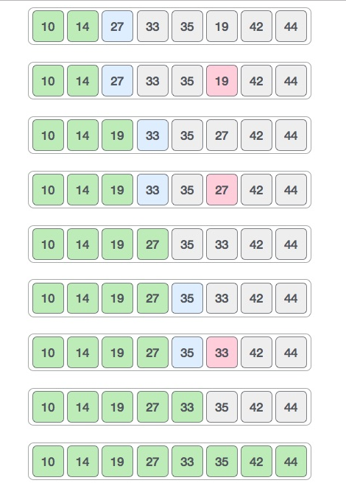

Slide 41
Algorithm
A is an array of n elements. The variable loc and small keeps track of the position of the smallest element
Step1: Start
Step2: Read the size of the array into n
Step3: Read the array elements
Step4: Repeat the following steps 5 to 10 for i=0 to n-1
Step 5: Initialize small=a[i] , loc=i
Step6: Repeat step 7 for j=i+1 to n-1
Step7: If (a[j]<small)
small=a[j] loc=j [End if]
[end of step 6 for loop]
Step 8: a[loc] = a[j]
Step 9: a[j]=small

Slide 42
Step 10:[end of step 4 for loop]
Step 11: Print the sorted array
Step 12: Stop

Slide 43
for(i=0;i<=n;i++)
{ small=a[i];
loc=i;
for(j=i+1;j<n;j++)
{
if(a[j]<small)
{
small=a[j];
loc=j;
}
}
a[loc]=a[i];
a[i]=small;
}

Slide 44
Merge sort
Merge sort is a sorting technique based on divide and conquer technique. Merge sort first divides the array into equal halves and then combines them in a sorted manner.

Slide 45
Example: Consider the elements 38, 27, 43, 3, 9, 82, 10.
Initially low=0,high=6 and mid=(0+6)/2=3.therefore array divides into 2 sub arrays at index 3.The 1st sub array contains 38,27,43,3 and the right sub array has 9,82 and 10.Further the left sub array gets divided at index 1 as low=0,high=3 and mid=(0+3)/2=1.The right sub array divides at index 5 as low=4,high=6 and mid=(4+6)/2=5.The same process continues till each array has only a single element. Then the sub arrays are merged after sorting.

Slide 46
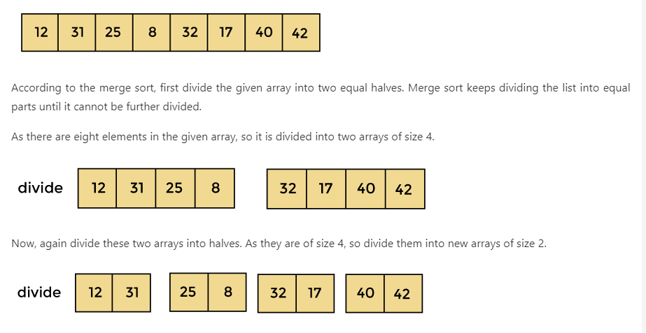
Working of Merge sort Algorithm

Slide 47
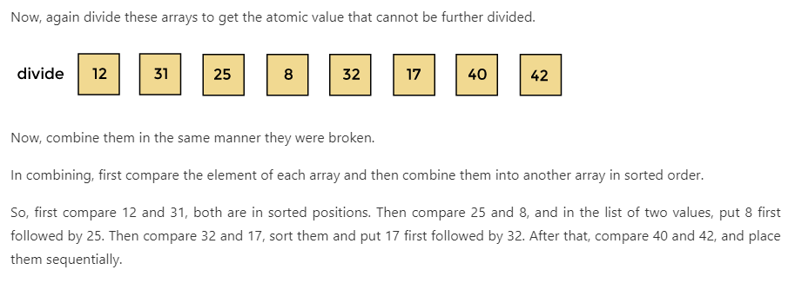

Slide 48
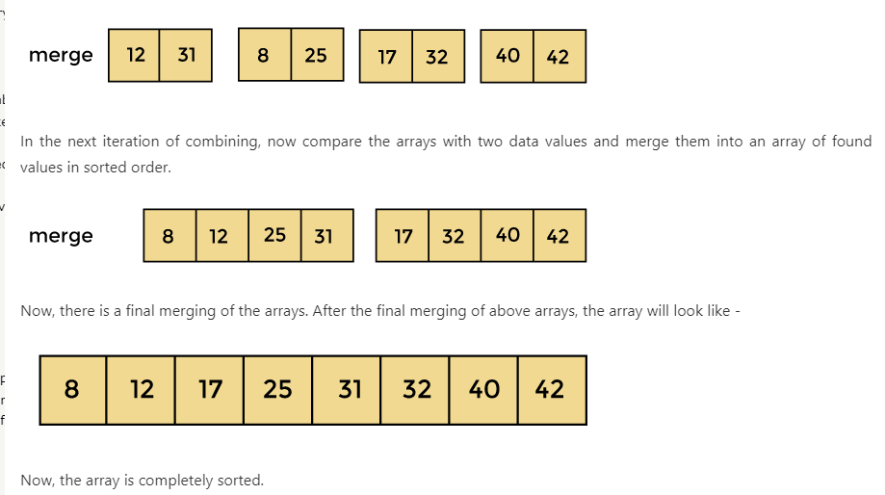

Slide 49
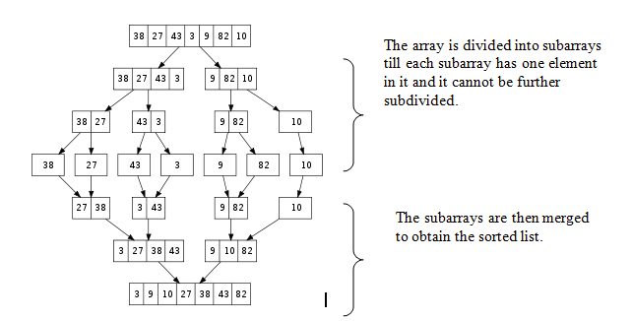

Slide 50
Algorithm: Merge Sort
Partition (a, low, high)
Step1: if(low<nigh) then
Step 2: Mid=(low+high)/2
Step 3: Call partition(a, low, mid)
Step 4: Call partition(a,mid+1,high)
Step 5: Call merge(a, low, mid, high)
endif
merge(a, low, mid, high)
step 1:i=low, j=mid+1, k=low
step 2:while(i<=mid) && (j<=high) do
step 3: if(a[i]<a[j]) then
c[k]=a[i];

Slide 51
k=k+1
i=i+1.
Else
c[k]=a[j]
k=k+1
j=j+1
step 4:
while(i<=mid)
c[k]=a[i];
k=k+1
i=i+1.
step 5:
while(j<=high)

Slide 52
c[k]=a[j]
k=k+1
j=j+1
end of while loop.
Step 6: for i=low to k-1 do
A[i]=c[i]
End of for loop.
Step 7:End

Slide 53
Example: Consider the numbers 3, 5, 2, 6, 8
So, here is the sequence of calls: a[] = {3, 5, 2, 6, 8} low = 0; high = 4; mergesort(a, 0, 4) mid = 0 + 4 / 2 = 2 mergesort(a, 0, 2) mergesort(a, 3, 4) merge(a, 0, 2, 4)

Slide 54
/* Program to perform Merge Sort */ #include<stdio.h>
#include<conio.h>
void partition(int [20],int,int);
void merge(int [20],int,int,int);
void main()
{
int i,j,k,key,a[20],n;
clrscr();
printf("Enter the number of elements\n");
scanf("%d",&n);
printf("Enter the elements\n");
for(i=0;i<n;i++)

Slide 55
scanf("%d",&a[i]);
printf("Orginal list\n");
for(i=0;i<n;i++)
printf("%d\t",a[i]);
partition(a,0,n-1);
printf("\nSorted list\n");
for(i=0;i<n;i++)
printf("%d\t",a[i]);
getch();
}
void partition(int a[20],int lb,int ub)
{
int mid;

Slide 56
if(lb<ub)
{
mid=(lb+ub)/2;
partition(a,0,mid);
partition(a,mid+1,ub);
merge(a,lb,mid,ub);
}
}
void merge(int a[20],int lb,int mid,int ub)
{
int c[20],i,j,k;
i=lb;
k=lb;

Slide 57
j=mid+1;
while((i<=mid)&&(j<=ub))
{
if(a[i]<a[j])
{
c[k]=a[i];
k++;
i++;
}
else
{
c[k]=a[j];
k++;

Slide 58
j++;
}
}
while(i<=mid)
{
c[k]=a[i];
k++;
i++;
}
while(j<=ub)
{
c[k]=a[j];
k++;
j++;
}
for(i=lb;i<k;i++)
a[i]=c[i];
}
Example: Consider the numbers 3, 5, 2, 6, 8
So, here is the sequence of calls: a[] = {3, 5, 2, 6, 8} low = 0; high = 4; mergesort(a, 0, 4) mid = 0 + 4 / 2 = 2 mergesort(a, 0, 2) mergesort(a, 3, 4) merge(a, 0, 2, 4)

Slide 59
j++;
}
for(i=lb;i<k;i++)
a[i]=c[i];
}

Slide 60
Quick Sort
Quicksort is a divide-and-conquer sorting algorithm in which division is dynamically carried out.
It sorts by partitioning the array into two pieces separated by a single element that is greater than all the elements on the left side and smaller than all the elements in the right side.
This single element called as the key element is in its correct position in the sorted list. Then the process is repeated to the two pieces separately

Slide 61


Slide 62
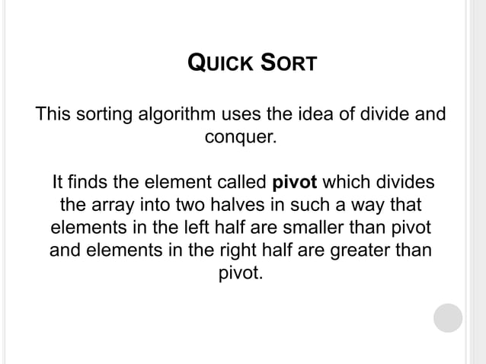

Slide 63
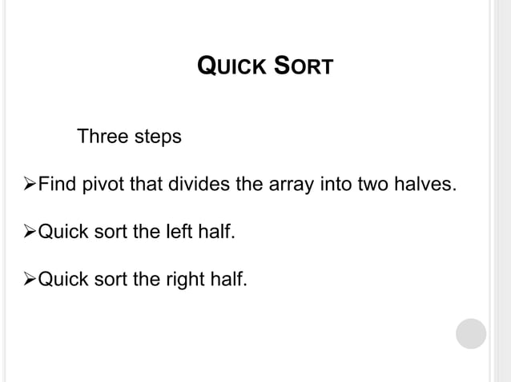

Slide 64
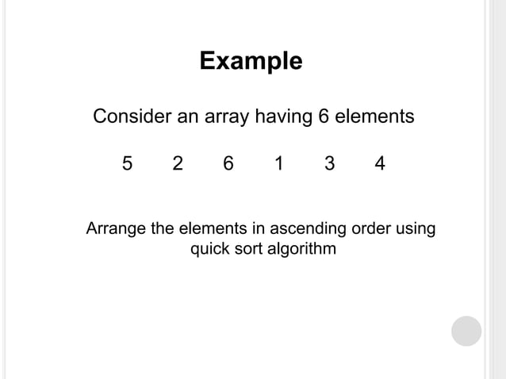

Slide 65
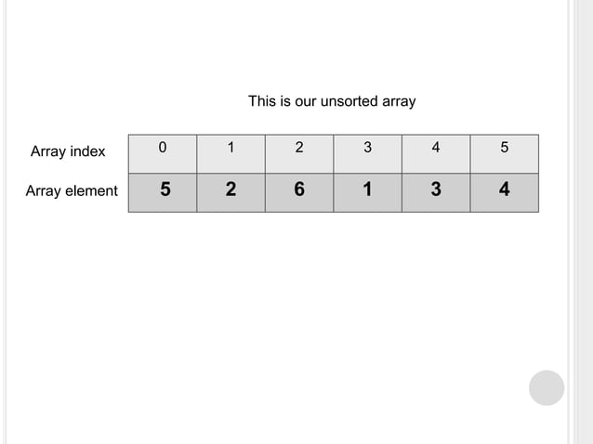

Slide 66
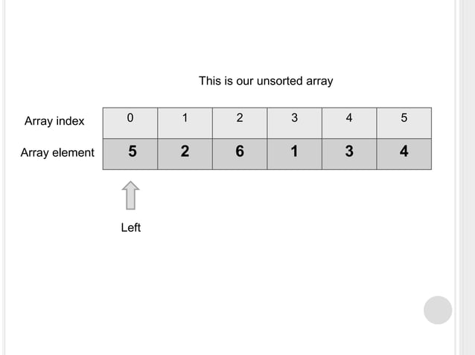

Slide 67
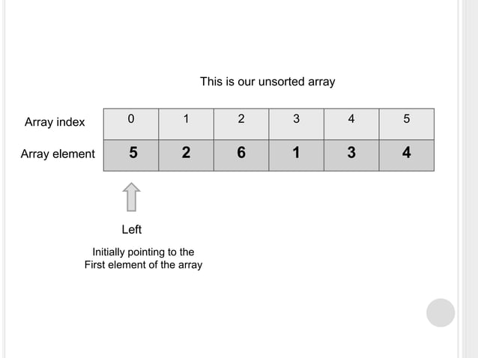

Slide 68
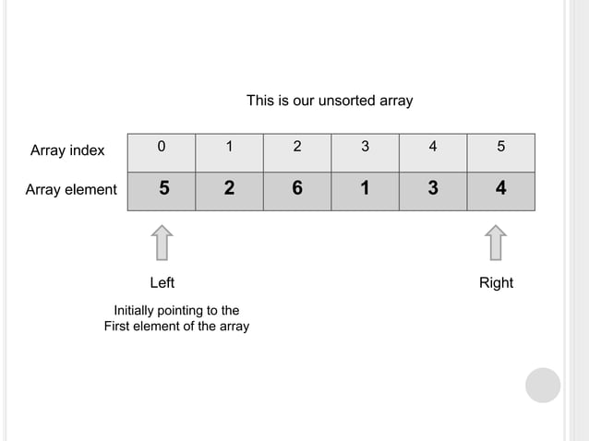

Slide 69
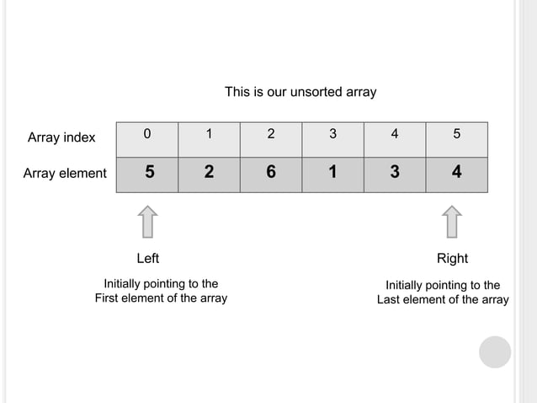

Slide 70
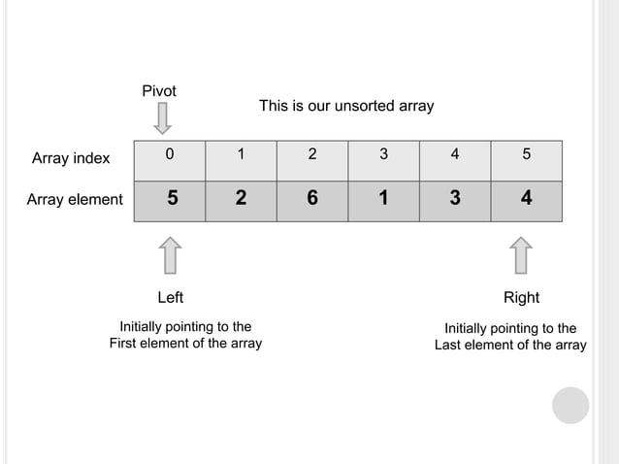

Slide 71
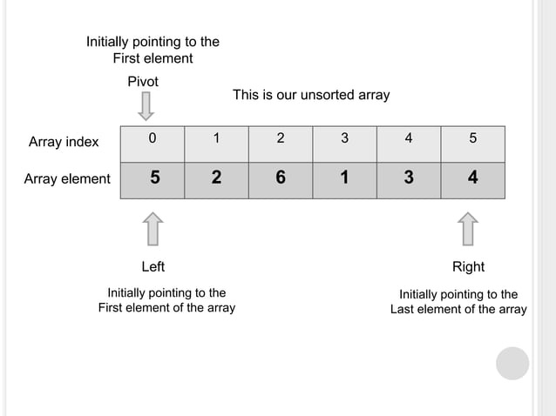

Slide 72
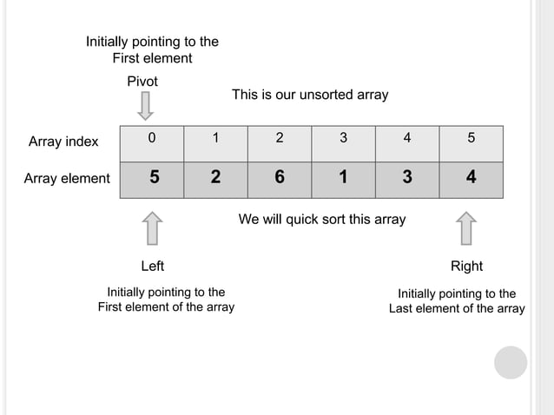

Slide 73
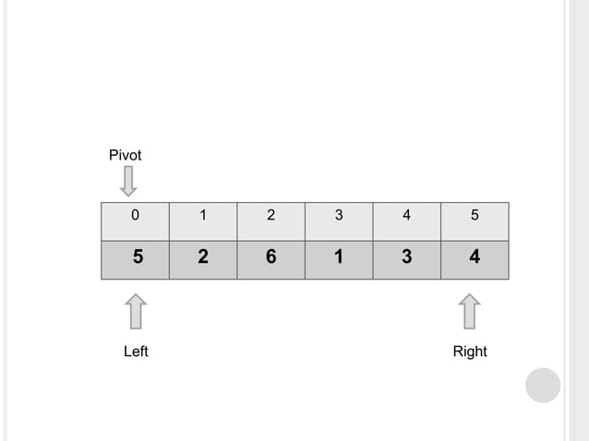

Slide 74
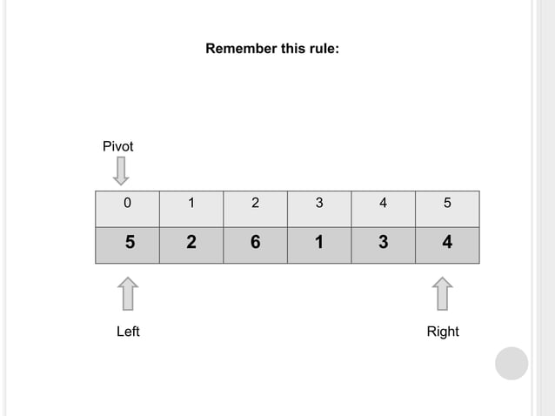

Slide 75
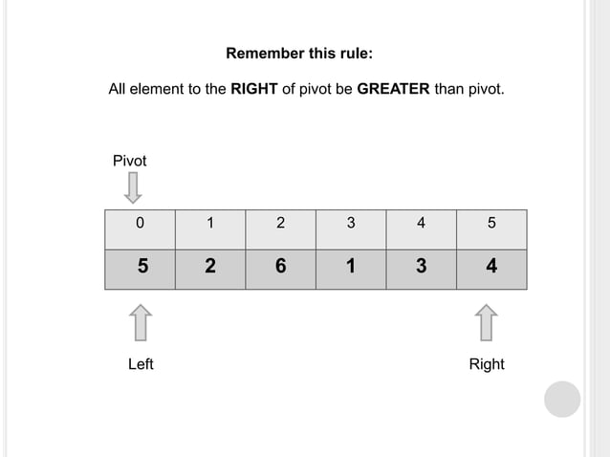

Slide 76
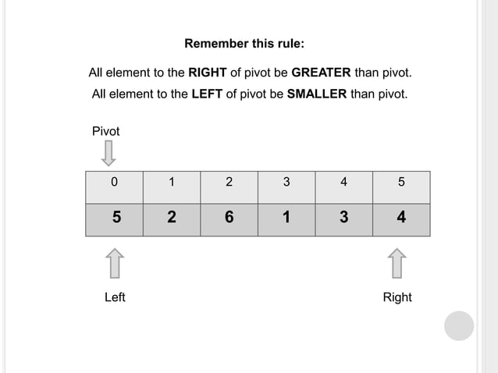

Slide 77
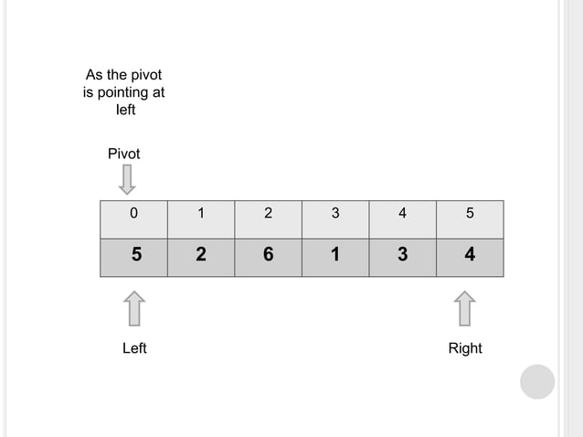

Slide 78
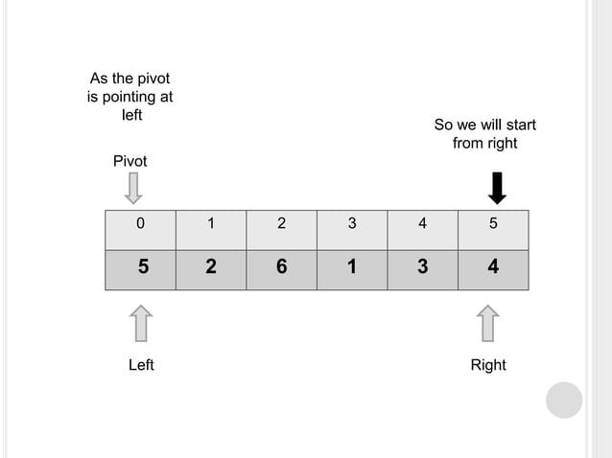

Slide 79
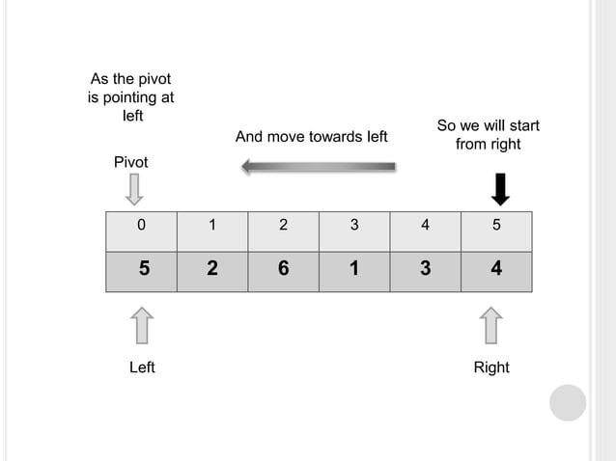

Slide 80
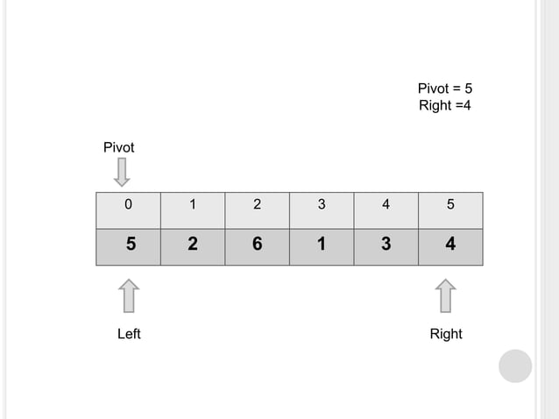

Slide 81
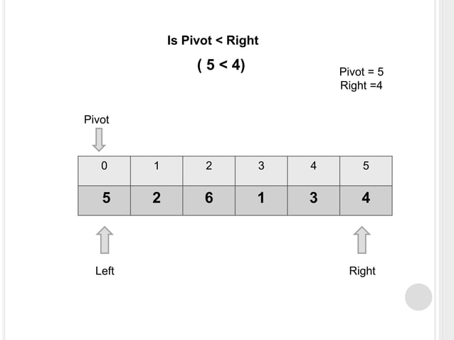

Slide 82
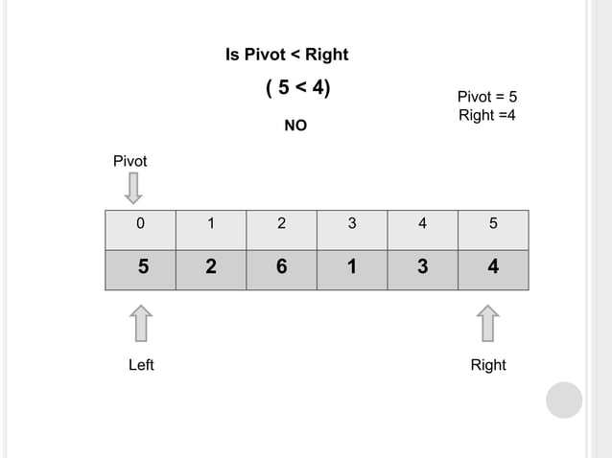

Slide 83
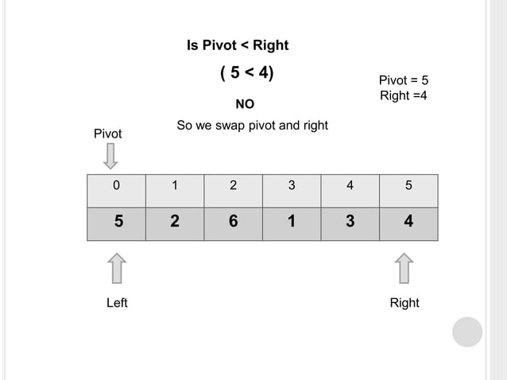

Slide 84
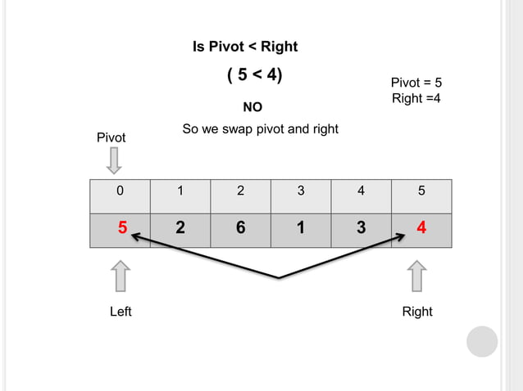

Slide 85
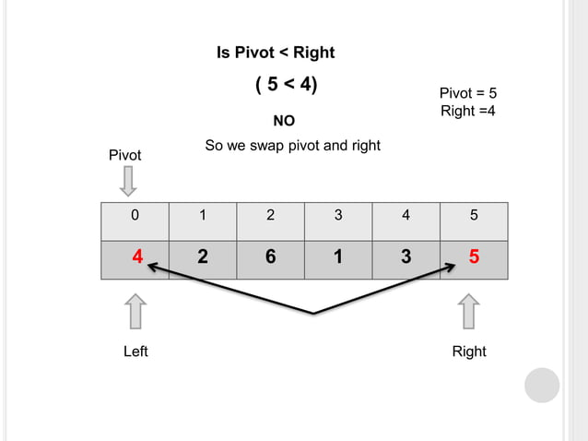

Slide 86
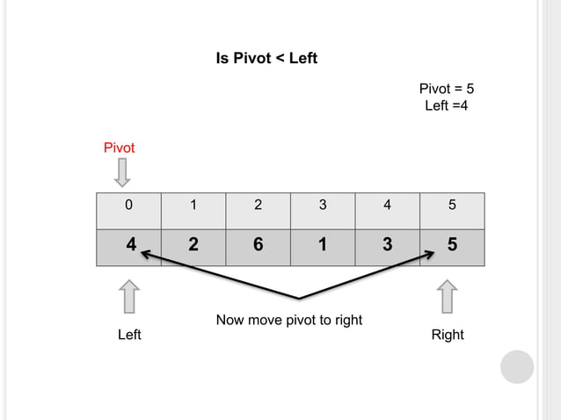

Slide 87
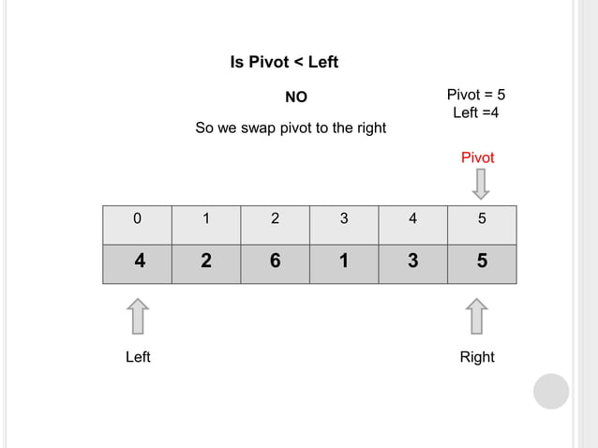

Slide 88
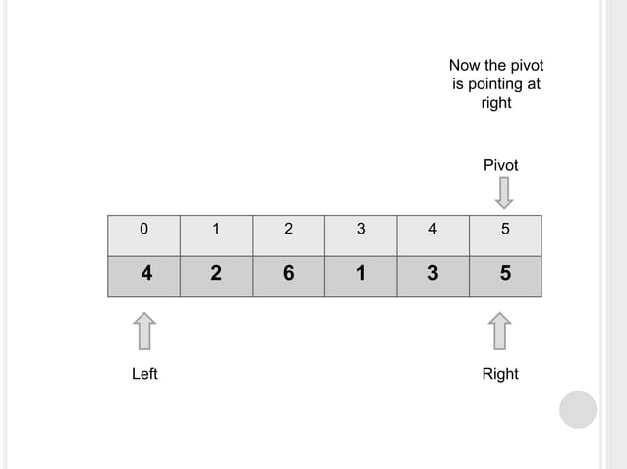

Slide 89
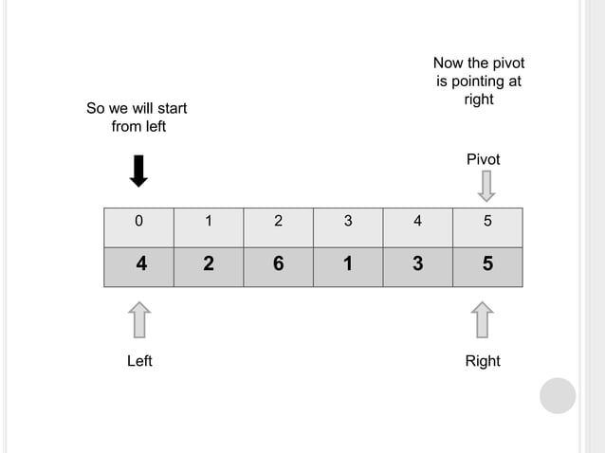

Slide 90


Slide 91


Slide 92


Slide 93


Slide 94


Slide 95


Slide 96


Slide 97


Slide 98


Slide 99


Slide 100


Slide 101


Slide 102


Slide 103


Slide 104


Slide 105


Slide 106


Slide 107


Slide 108


Slide 109


Slide 110


Slide 111


Slide 112


Slide 113


Slide 114


Slide 115


Slide 116


Slide 117


Slide 118


Slide 119


Slide 120


Slide 121


Slide 122


Slide 123


Slide 124


Slide 125


Slide 126


Slide 127


Slide 128


Slide 129


Slide 130


Slide 131


Slide 132


Slide 133


Slide 134
Algorithm for Quick sort
Quicksort(a[],lb, ub)
Step1: if( lb<ub)
up=lb; down=ub; key=a[lb];
Step 2: while(lb<=ub)
Step 3: while(a[up] < key) up++;
[End of while]
Step 4: while(a[down] > key) down--;
[End of while]
Step 5 : if(up<down)
[Interchange a[up] with a[down]]
temp=a[up]; a[up]=a[down]; a[down]=temp;
[End of if]

Slide 135
[End of if]
[End of while loop in step 2]
Step 6: if(up>down)
[Interchange the key element a[lb] with a[down]]
temp=a[lb];a[lb]=a[down];a[down]=temp;
[End of if]
Step 7: Call quicksort(a, lb, down-1);
Step 8: Call quicksort(a, down+1,ub);
[End of if in step 1]

